Slide 1
Automatic Vehicle Detection and Tracking in Aerial Video
Final Year Project by Jonathan Brogan

Slide 2
Project Goal
Develop a system that can automatically detect and track a variable number of vehicles in top-down aerial video.
Detection and tracking of both moving and static vehicles.
Aerial video captured by low-altitude Unmanned Aerial Vehicle (UAV) with fixed downwards facing camera.

Slide 3
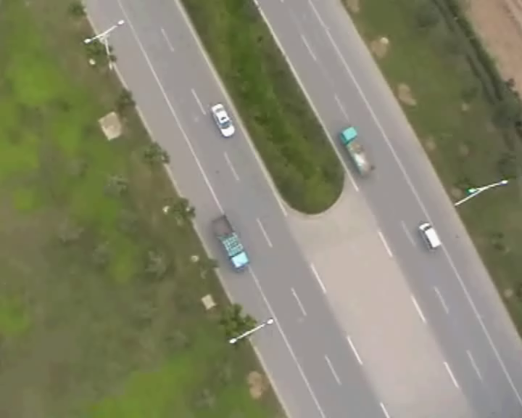
Example video

Slide 4
Why bother?
In recent years there has been a considerable adoption of UAV systems for military, civil and commercial uses.
Applications include:
Aerial surveillance and reconnaissance.
Automatic Target Recognition
Automatic Traffic Monitoring
Domestic Policing
Border Control
Search and Rescue

Slide 5
Challenges (Detection)
Vehicles size, shape and orientation varies considerably depending on the UAV’s approach angle, flight altitude and relative position.
Many of the vehicles details are not visible due to Low resolution imagery & small size of vehicles.
Images have considerable motion blur due to atmospheric turbulence.
Different vehicle types and colours.

Slide 6
Challenges (Detection)
Low contrast between vehicles and background.
Changing lighting conditions.
Background scenes cluttered and complicated and can contain many object that resemble vehicles.
Vehicle Appearance influenced by neighbouring objects (Shadows).
Vehicle obstructions by environmental structures (trees, lamp posts).

Slide 7
Challenges (Tracking)
Non-linear motion of both the vehicle and UAV (unpredictable).
Vehicles can move at variable speed and change direction.
Vehicles motion in the video is a combination of both the movement of the vehicle and the movement of the UAV.

Slide 8
Challenges (Tracking)
Multiple vehicles with similar appearance moving in close proximity.
Potential for complete vehicle occlusions (underpasses).

Slide 9
Approach
Tracking by detection
Two tasks:
Vehicle Detection
Vehicle Tracking

Slide 10
System Overview

Slide 11
Stage 1: Region of Interest Selection
Why:
Accelerate Detection.
Searching over all image positions and at all scales is computationally expensive.
We expect vehicles to only occupy a small area of the image.

Slide 12
Region of Interest Selection
Observation: Man-made objects, specifically vehicles, have a large number of edges and corners compared to other topological features such as roads, trees and grassland. (Gleason et al. 2011).
Step1: Corner Detection
Step 2: Feature Density Estimation

Slide 13
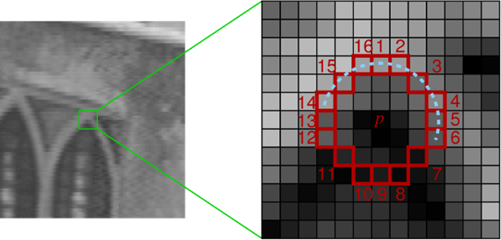
Corner Detection
Features from Accelerated Segment Test (FAST) detector
Similar corner response to Harris corner detector
Many times faster (5x)

Slide 14
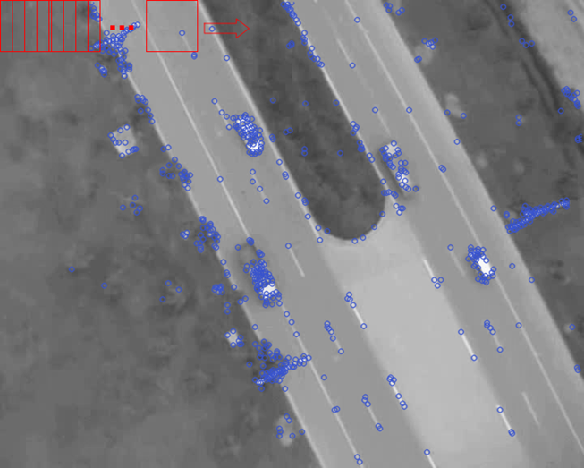
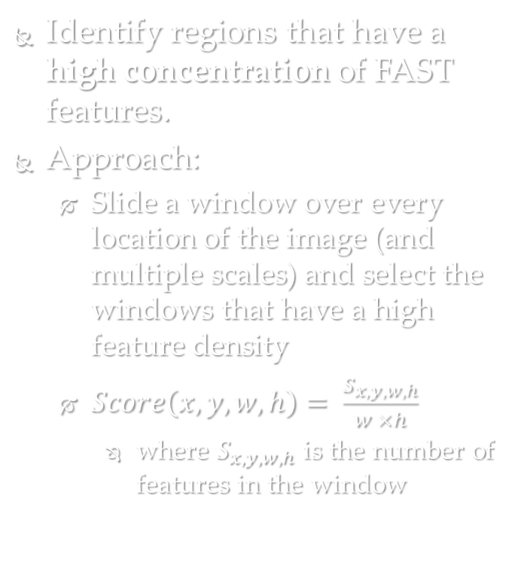
Feature Density Estimation
Identify regions that have a high concentration of FAST features.
Approach:
Slide a window over every location of the image (and multiple scales) and select the windows that have a high feature density
$Score\left(x,y,w,h\right)= \frac{S_{x,y,w,h}}{w ×h}$
where $S_{x,y,w,h}$ is the number of features in the window

Slide 15
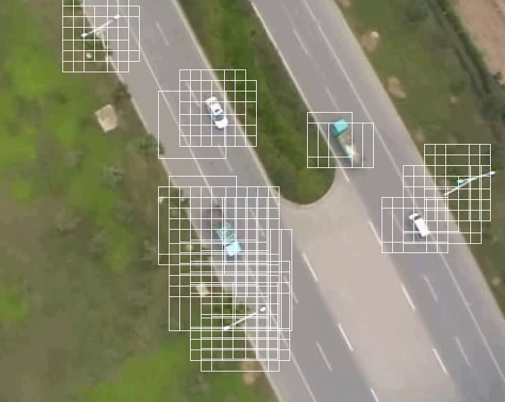
ROI Selection

Slide 16
Stage 2: Classification
Categorise the regions of interest into vehicle and non-vehicle classes.
Step 1: Feature Extraction
Step 2: Classification
Step3: Non-maximum suppression

Slide 17
Feature Extraction
Feature Extraction is the process of transforming an image into a reduced representation that describes the most informative features in the image.
Used to transform the image patches into a representation (feature vector) that is presented to a classifier.

Slide 18
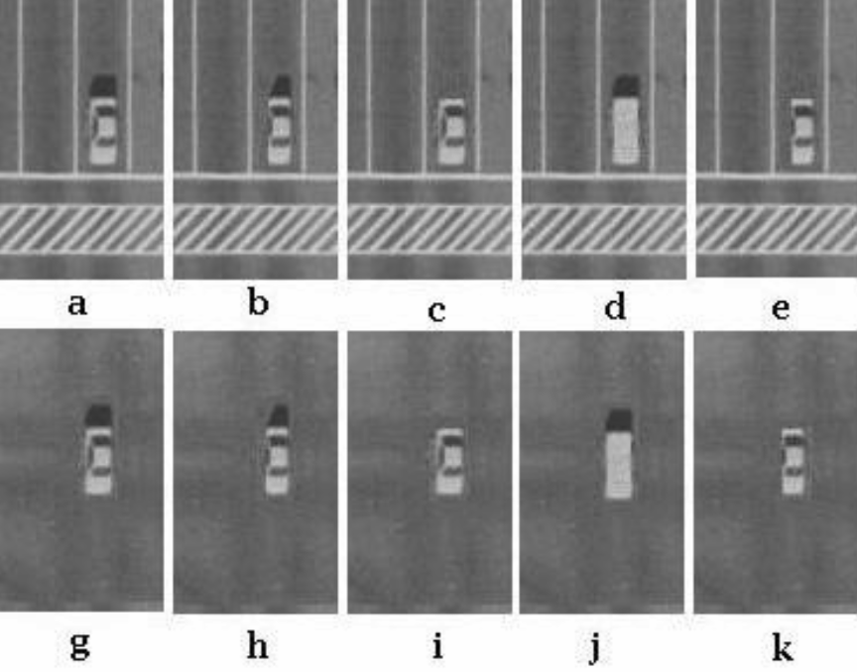
Feature Extraction
Humans are good at recognising vehicles.
Zhao and Nevatia (2001) carried out a series of psychological tests to find out what features of vehicles humans used to allow use to make the decision about the presence of a vehicle.
Results: Most significant features where the rectangular shape and the presence and position of frontal and rear windshields.
=> Need a descriptor that encodes this shape information.

Slide 19
Histogram of Oriented Gradients (HOG)
Idea: The shape of objects can often be described by the distribution of edge directions even without precise information of the edges themselves (Dalal and Triggs, 2005).
Why is this good:
Vehicle edges can generally be grouped into two major edge directions.
These edge directions are largely perpendicular.
+ invariant to many of the geometric and photometric changes described before.
=> Common distribution of edge directions amount vehicles.

Slide 20
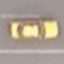

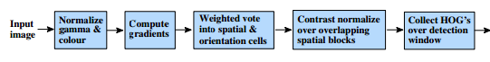
Edge Detection
Subdivide image patch into cells
Compute gradient for each pixel within the cell and accumulate into orientation bins (21) and store as histogram.
Normalise Blocks and combine histograms of each cell to create 21x4x4 –dimensional feature vector
Disadvantages:
Subdivision in 4x4 cells results in some cells having no edges/ capturing background edge information
[-1, 0, 1]
[…….......]

Slide 21
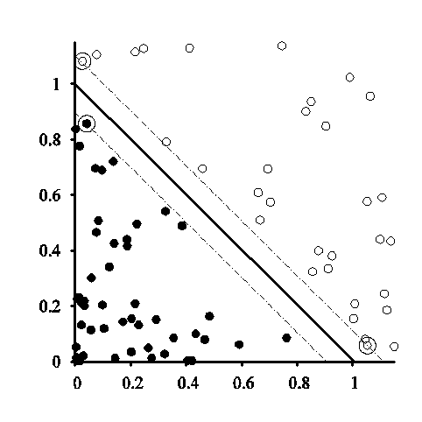
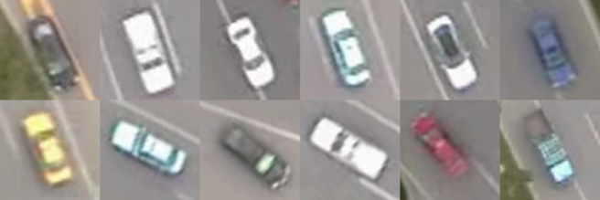






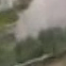





Classifier
Four separate Support Vector Machines (SVM) are trained on sample vehicle images that are categorised into one of four angular offsets to the horizontal: 0°, 45°, 90° and 135°.
The four SVM’s are combined to construct a single classifier that evaluates a rotationally invariant response for a single HOG feature vector.

Slide 22
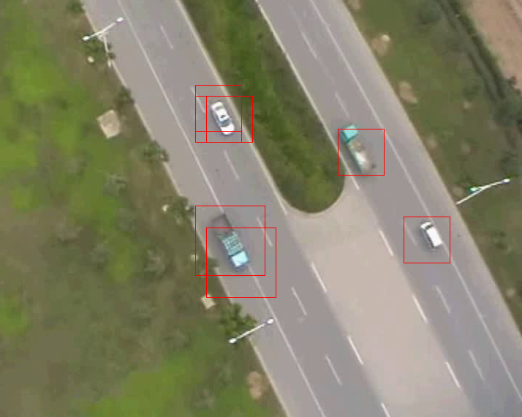
Classification

Slide 23
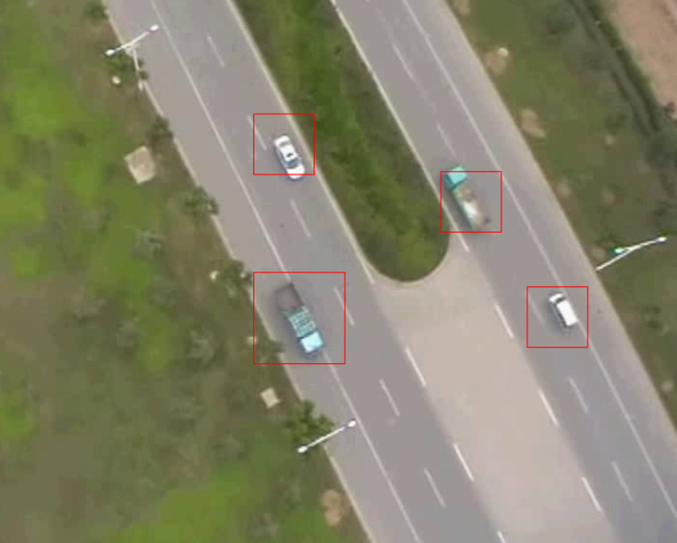
Non-maximum Suppression

Slide 24
Stage 3: Tracking
The process of locating a vehicle (or multiple vehicles) in a sequence of images.
Achieved by the continuous application of the vehicle detection algorithm and the association of detector responses across consecutive frames.

Slide 25
Tracking Algorithm
First Frame:
Create vehicle tracker for each detector response.
Frame N:
1. Associate detections with existing trackers.
2. Initialise tracker for vehicle detections not allocated in the previous step.
3. Terminate trackers that have not received a detection for a number of frames.

Slide 26
Particle Filtering
Detector response association is difficult.
=> It is useful to generate some inference about the motion of a vehicle through the imagery.
Particle Filtering is a method of performing model estimation using simulation.
Provides a probabilistic framework for encoding the state and dynamics (model of how the state changes from frame to frame) of the vehicles.

Slide 27
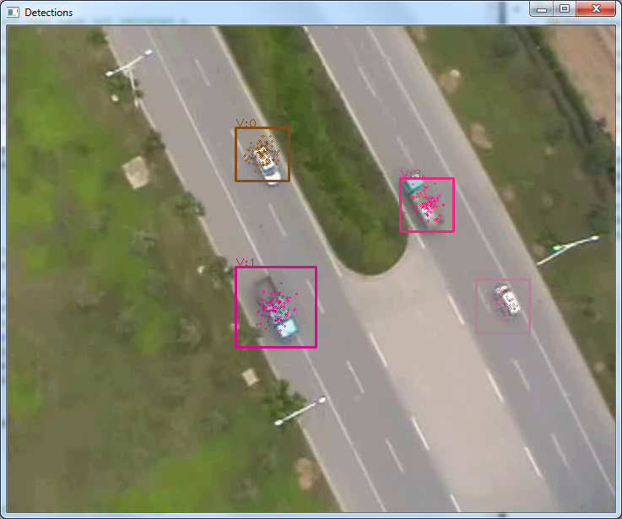
Particle Filtering
The goal of the particle filter is to maintain an accurate representation of the posterior of the vehicle by exploiting both the observations provided by the vehicle detector and a dynamical model of a vehicle motion.

Slide 28
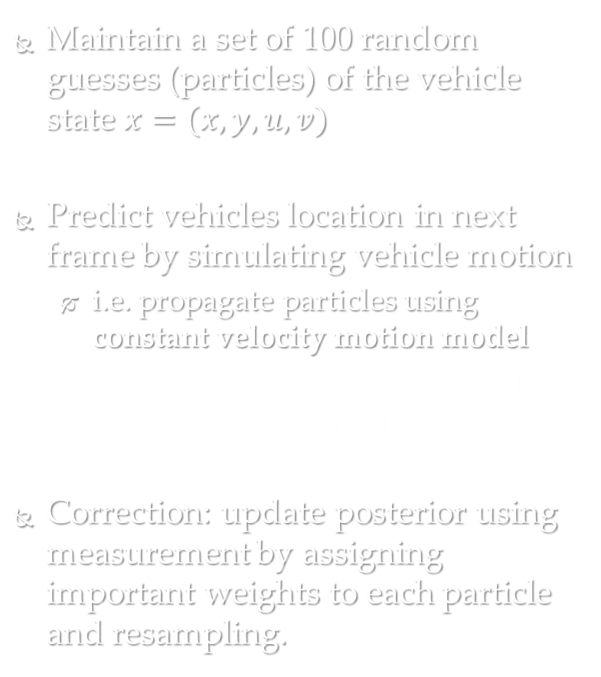
Particle Filtering
Maintain a set of 100 random guesses (particles) of the vehicle state $x=(x,y,u,v)$
Predict vehicles location in next frame by simulating vehicle motion
i.e. propagate particles using constant velocity motion model
$${(x,y)}_{t}={(x,y)}_{t−1}+\left(∆t\right){\left(u,v\right)}_{t−1}+ε_{(x,y)}$$
$${(u,v)}_{t}={(u,v)}_{t−1}+ε_{(u,v)}$$
Correction: update posterior using measurement by assigning important weights to each particle and resampling.

Slide 29
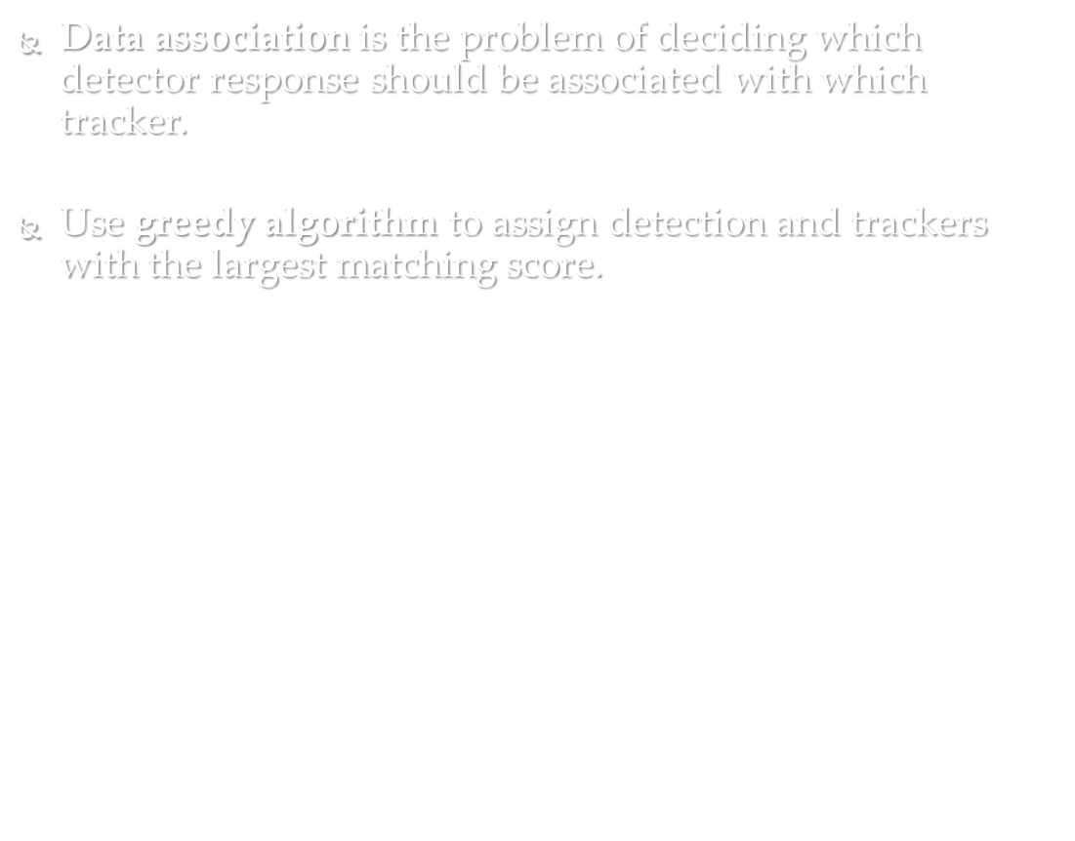
Data association
Data association is the problem of deciding which detector response should be associated with which tracker.
Use greedy algorithm to assign detection and trackers with the largest matching score.
The matching score for a tracker-detection pair $\left(tr,d\right)$ is calculated by evaluating the matching function$s(tr,d)$. This function considers both the vehicle appearance and the distance between the detection and the trackers expected position.
$S\left(tr,d\right)=I\left(H_{{tr}_{d}},H_{d}\right)∙(α∙\sum_{pεtr}^{N}{p_{Ν\left(d−p\right)}})$
Where $p_{N}\left(d−p\right)\sim N\left(d−p,σ^{2}\right)$ denotes the Normal distribution evaluated for the distance between $d$ and $p$ and $I\left(H_{{tr}_{d}},H_{d}\right)$ is the colour histogram correlation.

Slide 30
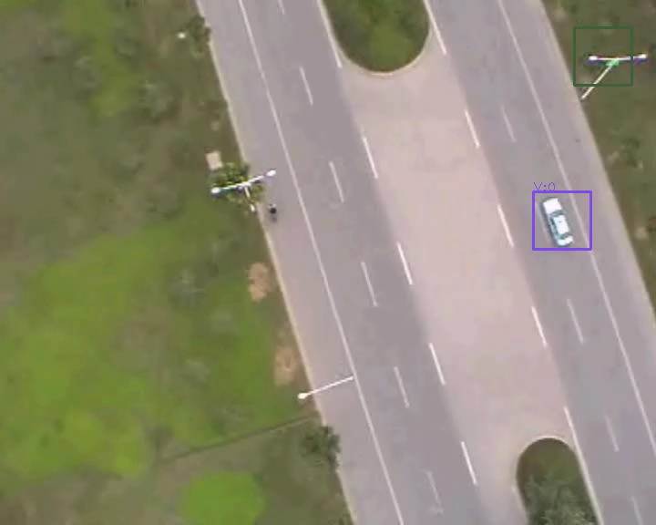
Video 1

Slide 31
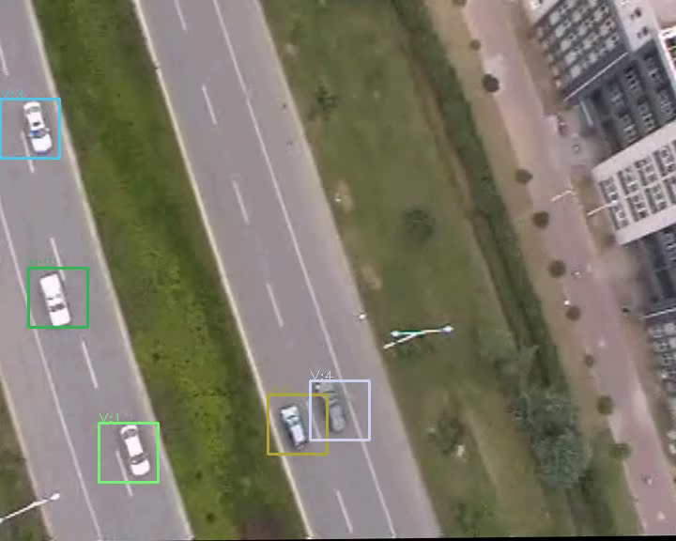
Video 2

Slide 32
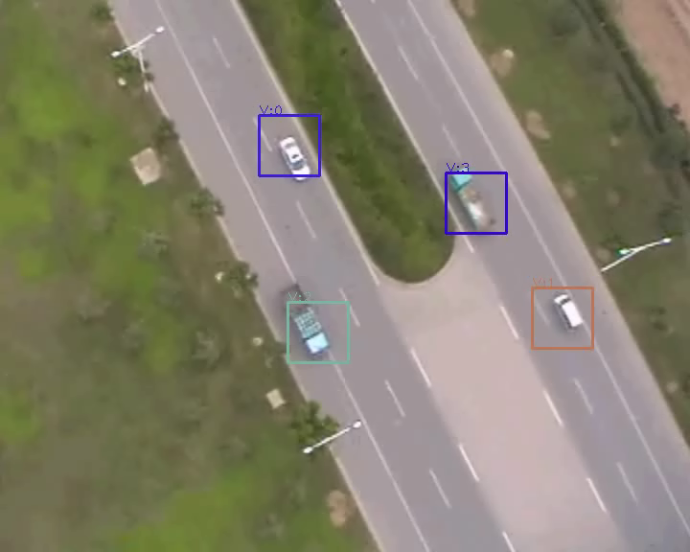
Video 3

Slide 33
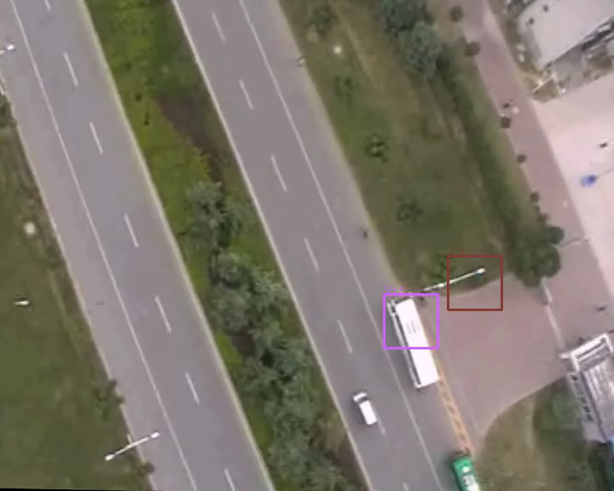
Video 4

Slide 34
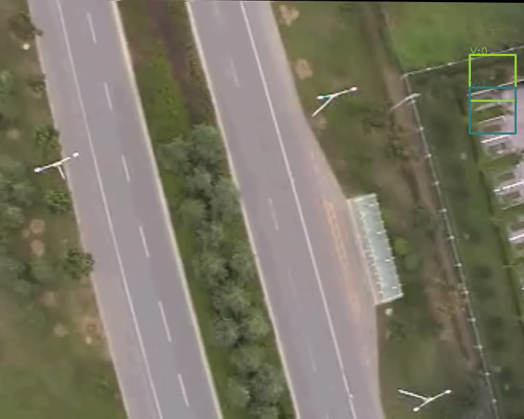
Video 5

Slide 35
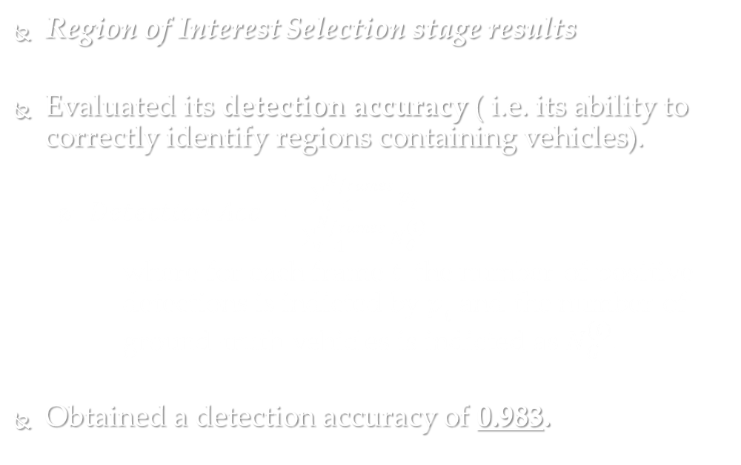
Results
Region of Interest Selection stage results
Evaluated its detection accuracy ( i.e. its ability to correctly identify regions containing vehicles).
$Detection Acc= \frac{\sum_{t=1}^{N_{frames}}{p_{t}}}{\sum_{t=1}^{N_{frames}}{N_{G}^{(t)}}}$
where for each frame$t$ the number of positive detections is indicted by $p_{t}$ and the number of ground-truth vehicles is indicted as${ N}_{G}^{(t)}$.
Obtained a detection accuracy of 0.983.

Slide 36
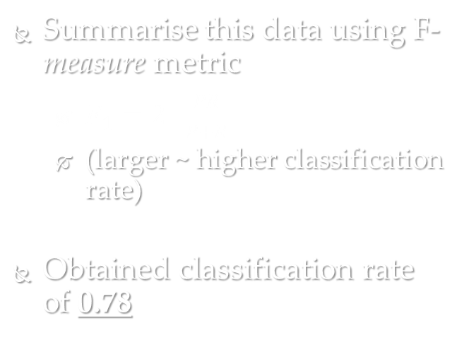
Results
Classification stage results
Evaluated its ability to correctly differentiate vehicle and non-vehicles regions in the imagery.
Evaluated accuracy over 178 frames of test video for each frame the number of correctly detected vehicles (True Positives), the number of background regions that were incorrectly classified as vehicles (False Positives) and the number of vehicles that were not detected (False Negatives) was recorded.
 | Actual Class
Predicted Class |  | Vehicle | Background
 | Vehicle | 725 | 350
 | Background | 57 | -
Summarise this data using F-measure metric
$F_{1}=2∙\frac{PR}{P+R}$
(larger ~ higher classification rate)
Obtained classification rate of 0.78

Slide 37
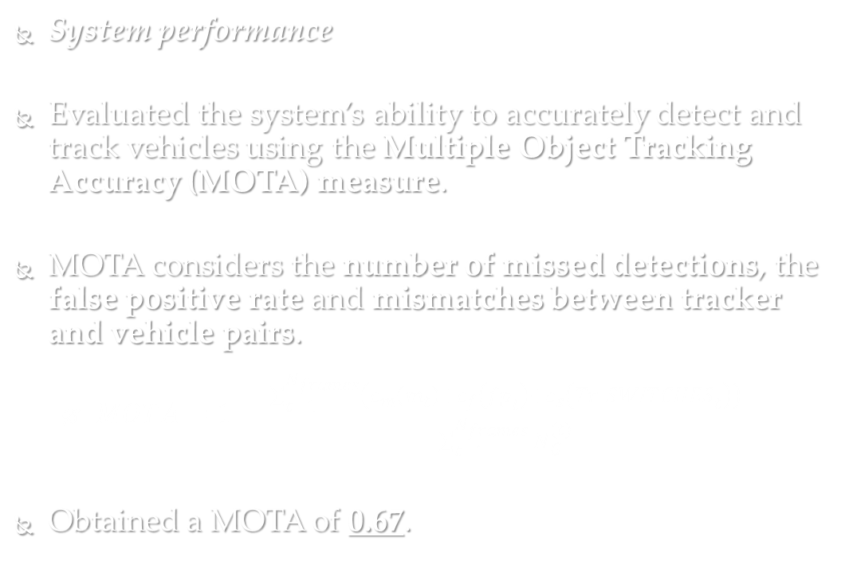
Results
System performance
Evaluated the system’s ability to accurately detect and track vehicles using the Multiple Object Tracking Accuracy (MOTA) measure.
MOTA considers the number of missed detections, the false positive rate and mismatches between tracker and vehicle pairs.
$MOTA=1−\frac{\sum_{t=1}^{N_{frames}}{\left(c_{m}\left(m_{t}\right)+c_{f}\left({fp}_{t}\right)+c_{s}\left({Tr_SWITCHES}_{t}\right)\right)}}{\sum_{t=1}^{N_{frames}}{N_{G}^{(t)}}}$
Obtained a MOTA of 0.67.

